Slide 1
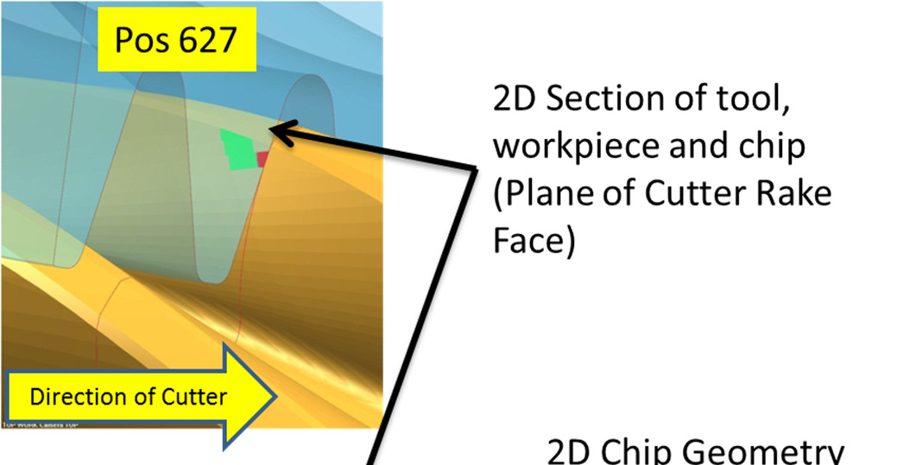
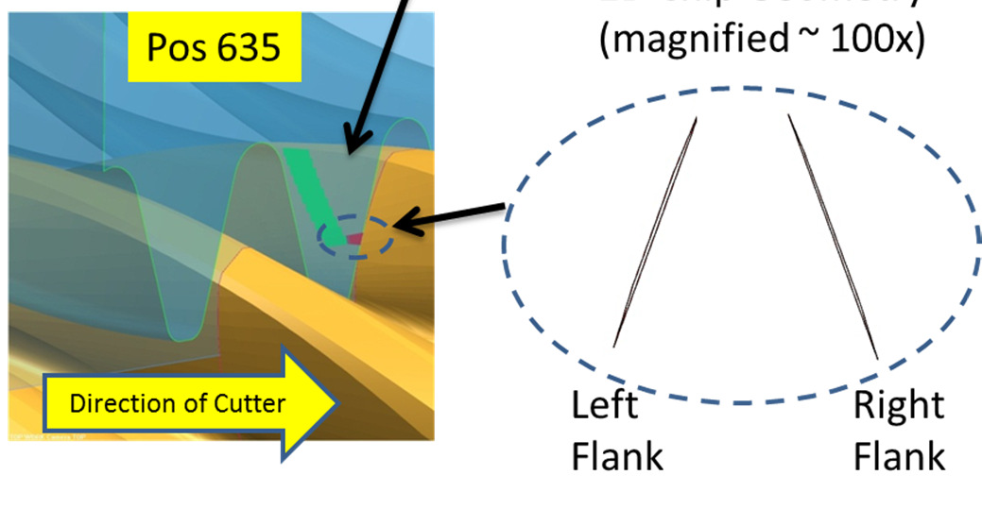
Unigraphics Simulation for Pinion Skiving
Results of this project allowed dramatic improvement in gear quality of BMW pinion.
David King and Pravin Khurana will present paper at ASME conference in June 2014

Slide 2
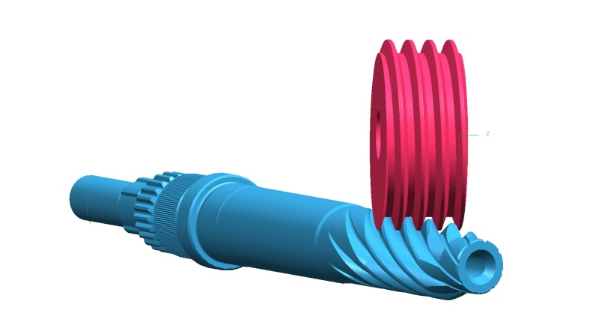
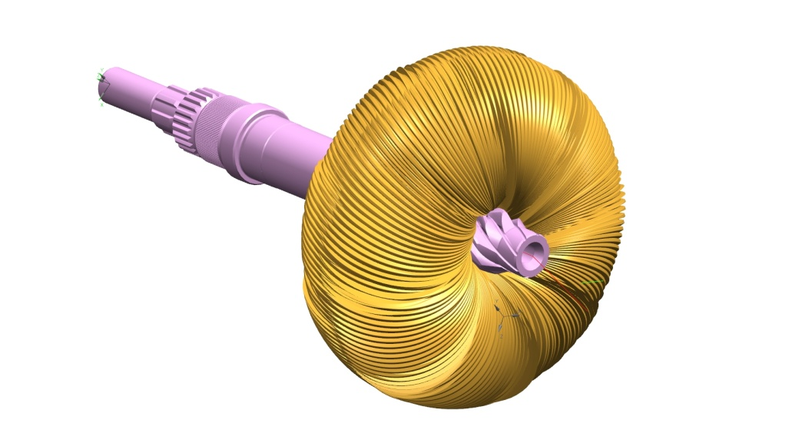
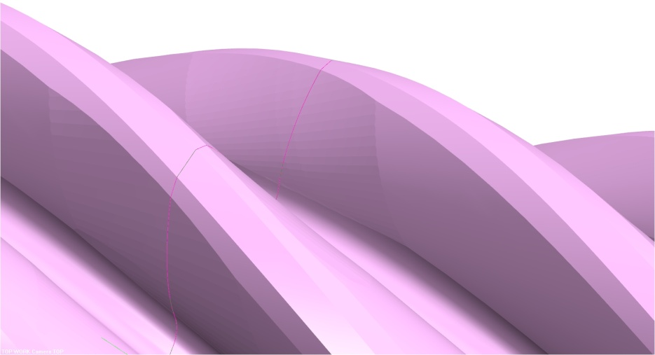
Unigraphics Simulation for Pinion Skiving
Deviation of Simulated
Profile compared to Theoretical Profile In Traverse Plane
Cross Section in Traverse Plane
Profile
Deviation
(microns)
Pinion Dia (mm)

